Slide 1
BINARY SEARCH

Slide 2
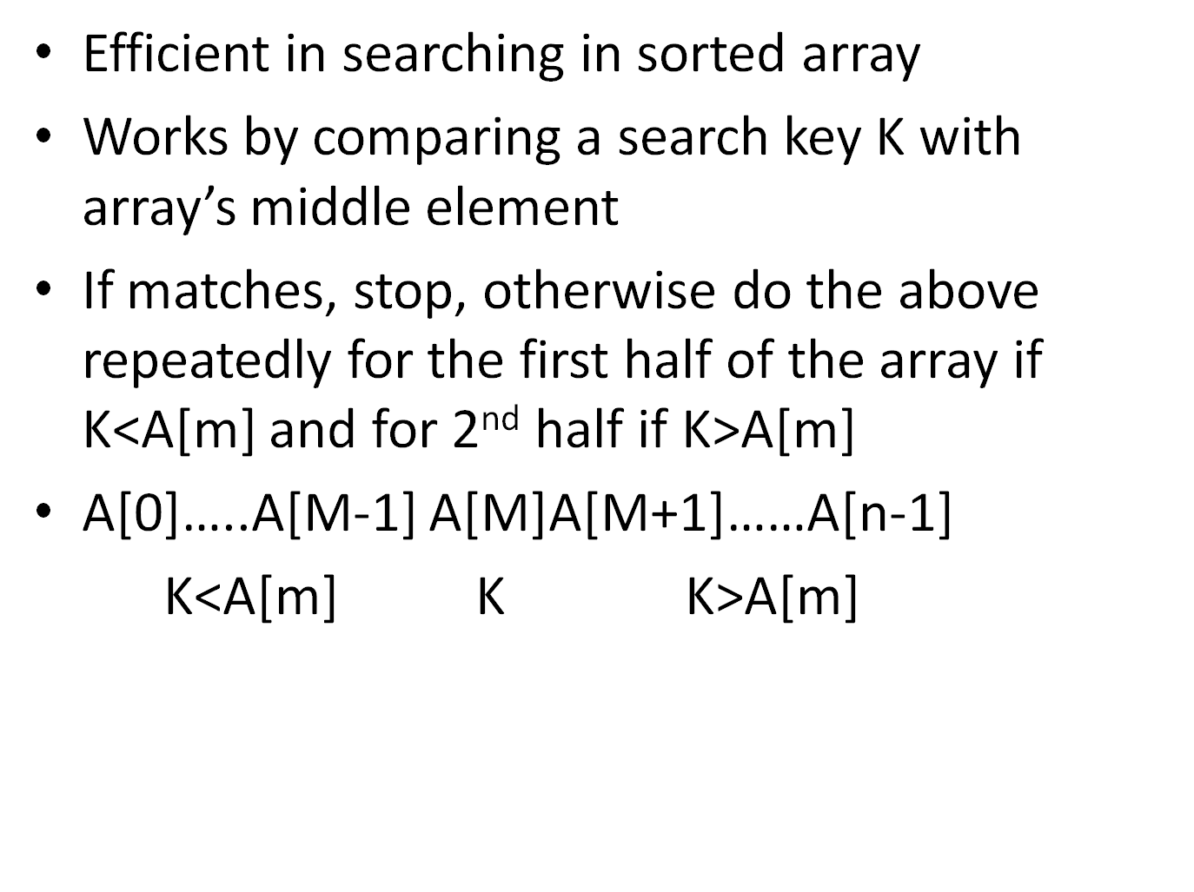

Slide 3
Searching element : 70 iteration 1: 3 – l, m=55, r=98 iteration 2: l=70, m=81, r=98 iteration 3: l=70,m-70, r=84
3 | 14 | 27 | 31 | 39 | 42 | 55 | 70 | 74 | 81 | 85 | 93 | 98

Slide 4
Alg :
L=0, r<- n-1
While l<= r do
M<- [(l+r)/2]
If K=A[m] return m
Else if K<A[m] r <- m-1
Else l <- m+1
Return -1

Slide 5
Analyse the efficiency :
Need to count the no of times the search key is compared with element of the array
After one comparison : we can determine whether k is smaller, larger or equal to A[m]
Ex : consider array with n elements
No of key comparisons in worst case C_{w} (n) – array don’t have search element
After one comparison, same situation but array size is half
Set a Recurrence relation from the above

Slide 6
C _{w}(n) = C _{w}([n/2])+1 for n>1, C_{w}(1) = 1
Solve RR, assume n=2k, solve it by backward substitution
C _{w}(n)= [log ₂ n]+1
Take n=2i
C _{w}(n)=[log ₂ n]+1
Log ₂ 2i +1 = log ₂ 2+log ₂i +1
1+log ₂i +1 = log ₂i +2
C _{w}([n/2])+1 = C _{w}(2i/2)+1 = C _{w}(i)+1
C _{w}(i) = log ₂ i + 1 = log ₂ i + 1+1 = log ₂i +2
Worst case : Ө(log n)

